Slide 1
MELBOURNE or SYDNEY

Slide 2

Problem Statement
Which city is better? Melbourne or Sydney?
Why?
Because it’s a great source of debate for Australian’s from Sydney & Melbourne
Because it would be interesting to understand more about both cities from a tourists perspective
If you were opening up a restaurant you might be interested to understand which suburbs are best suited and/or under served?
How?
Use the areas defined by Melbourne & Sydney city councils
Using data to compare suburbs/neighbourhoods in each city and across both
Foursquare API and ABS census data (2016) to create clusters (kmeans) and compare
Using data to compare a limited set of cafes, bars and restaurants and their ratings

Slide 3

Background: Melbourne v.s. Sydney
Sydney city council comprises of 25 km² smaller than Melbourne city council at 37 km² but still has more café’s then Melbourne. This could be because Melbournian’s love their coffee and prefer to call the venue a coffee shop? (See Melbourne Venues)
Both cities have a large number of café’s, restaurants and bars of many varieties that indicate their cosmopolitan populations. Sydney is a more business focused city, attracts tourists who are only visiting one city in Australia and is older than Melbourne.
Melbourne is Australia’s sporting capital (at least if you follow cricket and Aussie rules – AFL). Sydney sports fans typically follow rugby first, everything else second. Melbourne hosts the Formula 1 every year as well as the Australian Open (Tennis).

Slide 4

Summary of Results
Venues across both cities: Top Venue Types in each city and surrounding neighbourhoods

Slide 5
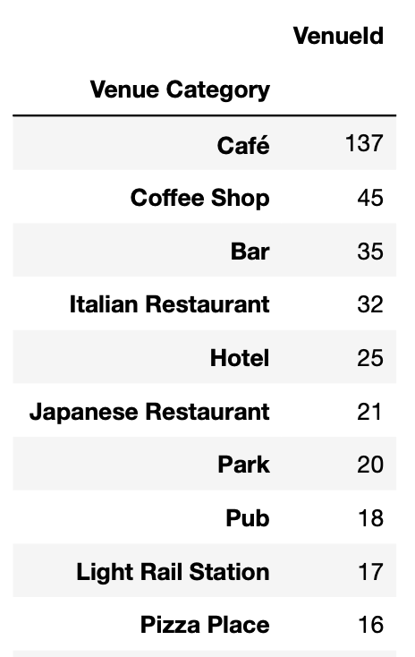
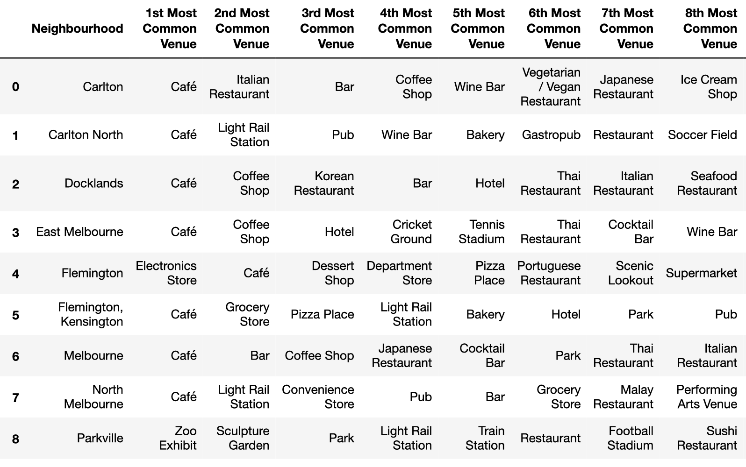
Venues (Melbourne)
Melbourne Venues are dominated by Café’s and Coffee Shops followed by bars. Very much confirming the reputation that Melbourne has for a great social culture.
Little Italy is within the Carlton Neighbourhood and contains many Italian Restaurants.
Everything looks good so far and confirms what we know about Melbourne
Top 10 Venue Types (Melb)
Top 10 Venue Types per Neighbourhood (Melb)

Slide 6
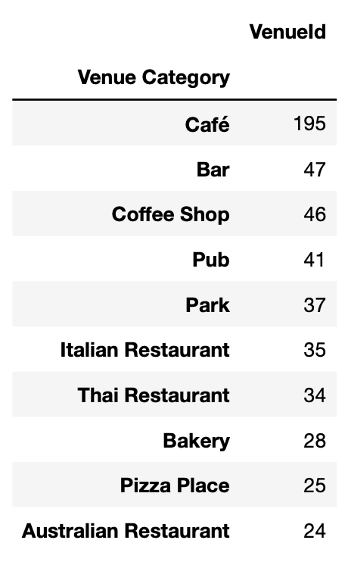
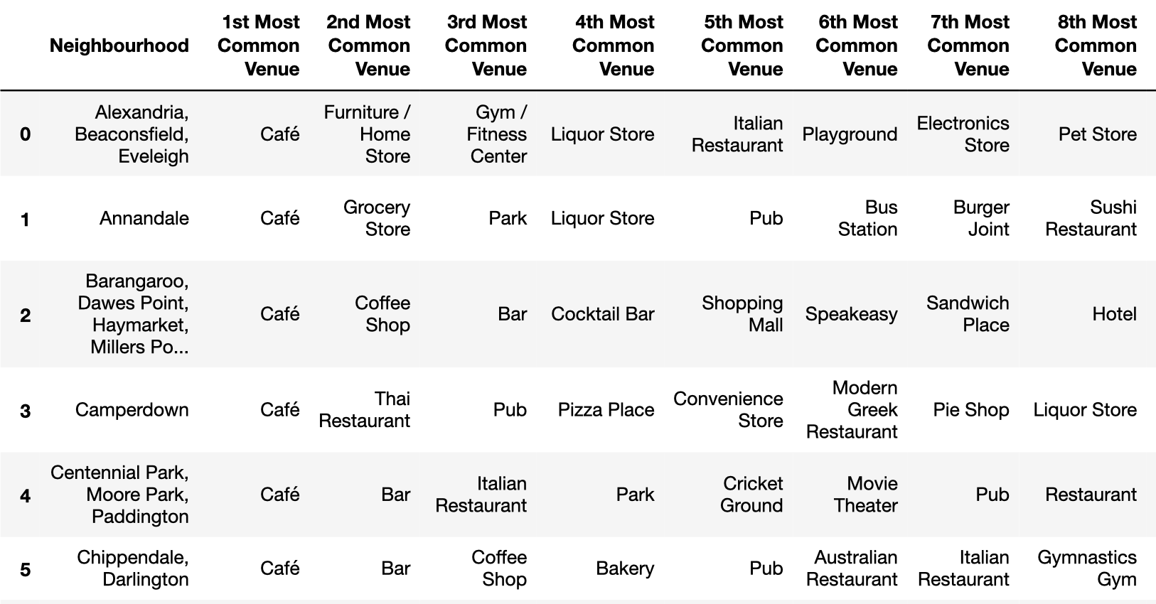
Venues (Sydney)
Sydney has a similar list of venues across the city council with more pubs and parks then Melbourne. Italian Restaurants also feature prominently as do Thai Restaurants.
Within the top venues in each neighbourhood you can clearly see some differences such as Alexandria with a furniture store, gym, playground and pet store.
Top 10 Venue Types (Melb)
Top 10 Venue Types per Neighbourhood (Melb)

Slide 7
Clustering/Segmentation
Review of clustering neighbourhoods based on their venue types and basic statistics (ABS 2016 postcode summary statistics)

Slide 8
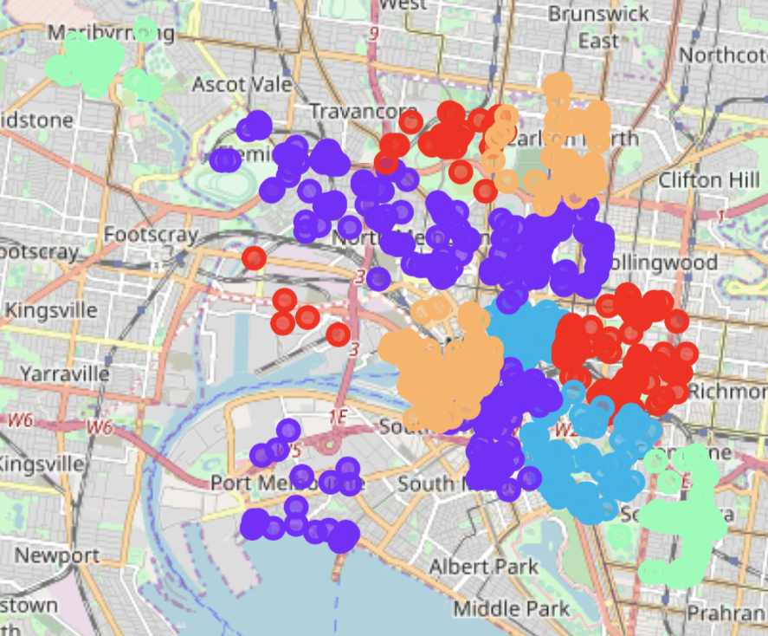
Neighbourhood Clusters/Segments
Melbourne
The clusters represent some interesting results, but also seem consistent with the venue data available for each area.
Red: includes the MCG Cricket/Football Stadium, Tennis Stadium, Zoo, Parks, etc (in both areas – the docks is a little weird)
Purple: covers the majority of Melbourne and represents areas with many restaurants and cafes (and are more residential than other areas)
Orange: this covers Docklands and North Carlton. It is an interesting combination
Green: interesting too, includes an old favourite with an upcoming area of Melbourne

Slide 9
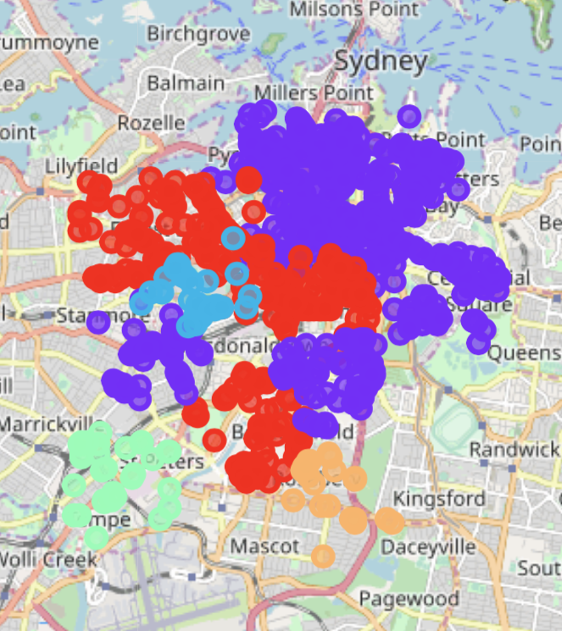
Neighbourhood Clusters/Segments
Sydney
I know a lot less (so hard to confirm what the data is saying) about Sydney, but can see that the clusters here look more like a wave as we move further away from the CBD.
Purple: Covers the main CBD, popular Habour venues and extends up through Paddington also popular with restaurants and bars.
Red: Lower density living, but similar features to purple. More focused on specific eating/drinking strips than the CBD
Orange: Closer to parks and airport, less densely populated and more grocery stores
Green: More industrial area closer to the airport

Slide 10
Battle of the Cities (CBD)
The next couple of slides show a summary of venue types and their ratings as provided by google users. The point of reference for these comparisons is the geocoder’s centroid (lat/long) returned for the main postcode (Melbourne = 3000, Sydney = 2000)

Slide 11
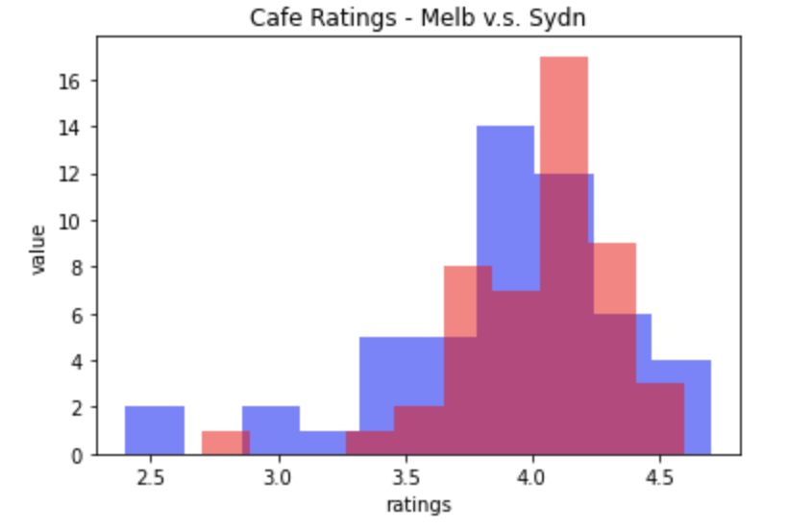
Cafes
Melbourne (blue) vs. Sydney (red)
Both cities have some great café’s with Melbourne having the highest scoring café, but Sydney’s data skewed towards the top end.
Overall it looks quite even for both cities when it comes to cafes. I’m going to call this one a draw.

Slide 12
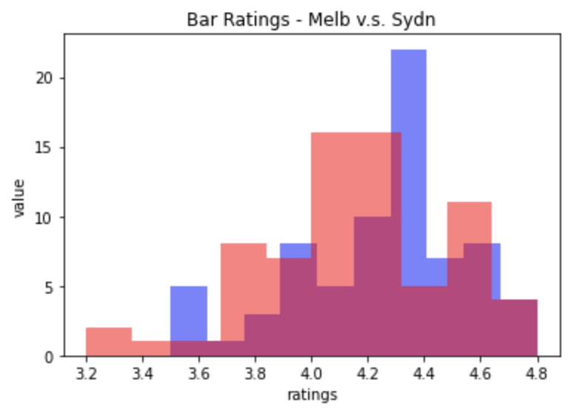
Bars
Melbourne (blue) vs. Sydney (red)
Again both cities scoring well and achieving the top score of 4.8. In this case Melbourne’s bar ratings are skewed towards the higher end and Sydney’s are more normal, with Sydney also scoring the lowest rating too.
It is pretty even, but Melbourne slightly edges out Sydney here.

Slide 13
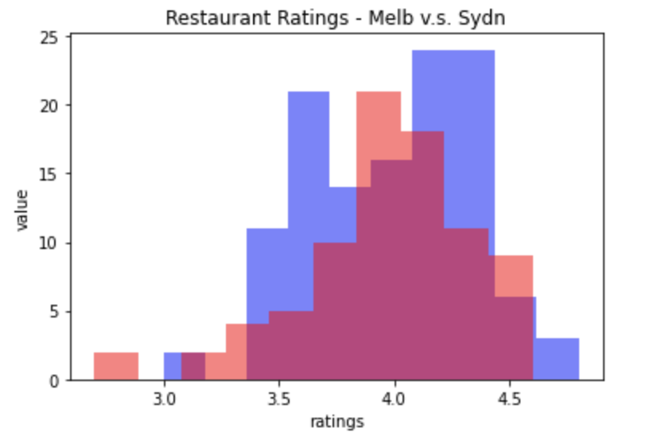
Restaurants
Melbourne (blue) vs. Sydney (red)
Melbourne scores the highest score for restaurants and has two peaks suggesting some good and not so good restaurants. Sydney’s data is however slightly skewed towards the higher end.
I think Melbourne slightly edges out Sydney here, what do you think?

Slide 14
Summary
 | Melbourne | Sydney
Bars | Winner (by a wisker) | Close
Cafes | Draw | Draw
Restaurants | Winner (by a wisker) | Close
General
Winner | Melbourne: 2/3 categories
Disclaimer: I’m from Melbourne and I love Sydney but there are a lot of assumptions and limitations of the analysis for various reasons. I’ve summarized some assumptions, limitations and excuses on the next page to try and explain. All in all a very close result and could go either way depending on the coordinates used to select the venues (perhaps filtering out bars from restaurants, etc).

Slide 15
Limitations, assumptions, excuses
Assumed that Sydney/Melbourne city council zones were appropriate for comparison. Both miss key parts that people would normally consider essential parts of each city, but had to limit the analysis in some way.
Foursquare venues listed in Australian seem somewhat limited, compared with the volume listed with google. Also, tourist volumes to each city may vary resulting in biases within each data set.
Google unfortunately limits venue search to 60 (over multiple pages)
I was able to manually move around the CBD (or part of to do a quick comparison but ultimately ran out of time to do more)
Would have been great to add some additional data from open data sources available. Ultimately this because a timely exercise of looking for data and thinking about how it could be used.
Probably need to provide some normalization of the neighbourhood statistics

